Slide 1
Cryptographic Fundamentals for IoT Security Engineering
Academy of Cryptography Techniques
CHAT
Dr. Pham Van Huong
0902 122 010
HuongPV@gmail.com

Slide 2
Contents
Identity and access management for IoT
1
2
Authentication credentials
3
IoT IAM infrastructure
4
Authorization an access control
4
5
5
4
Future directions of the IoT and cryptography
5

Slide 3
Identity and access management for IoT
Introductory discussion on identity and access management (IAM)
Discussion of the identity lifecycle
A primer on authentication credentials
Background on IoT IAM infrastructure
A discussion of IoT authorization and access control

Slide 4
IAM
IoT IAM is one aspect of an overarching security program that must be designed to mitigate this dynamic new environment, where:
New devices can be securely added to the network at a rapid pace and for diverse functions
Data and even devices can share not only within the organization but with other organizations
Privacy is maintained despite consumer data being collected, stored, and frequently shared with others

Slide 5
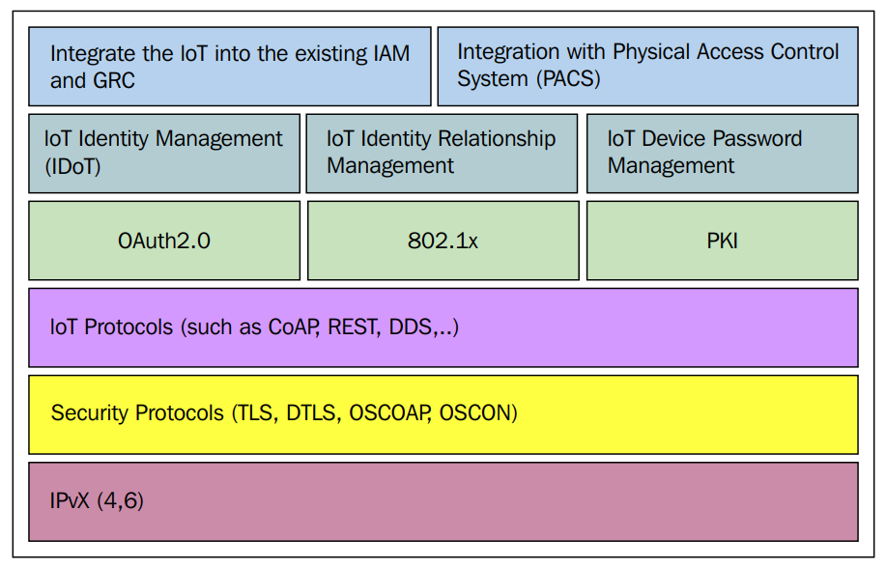
IAM
The following figure shows a holistic IAM program for the IoT:

Slide 6
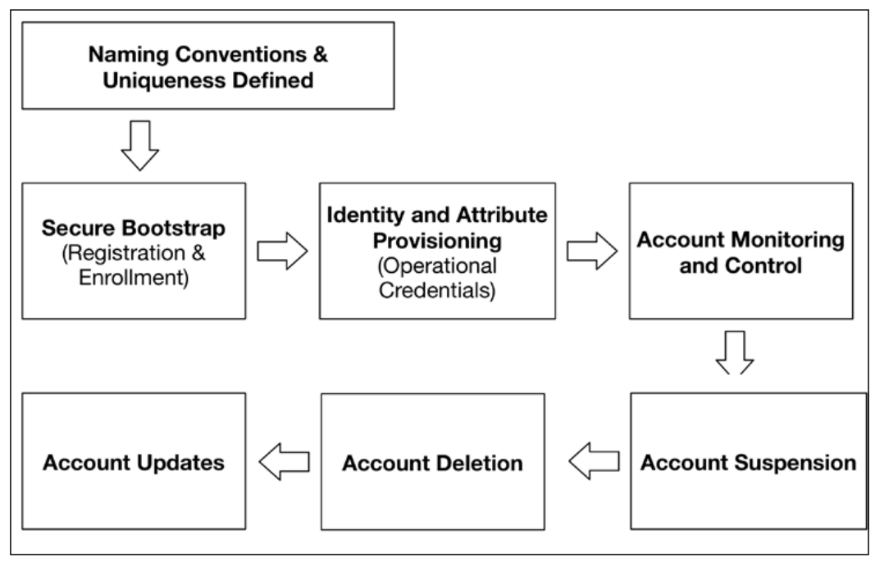
The identity lifecycle

Slide 7
Establish naming conventions and Naming a device
Establish naming conventions and uniqueness requirements
Uniqueness is a feature that can be randomized or deterministic
its only requirement is that there are no others identical to it
Global unique identifier (UUID) specified in RFC 4122 applies
Naming a device
Every time you access a restricted computing resource, your identity is checked to ensure that you are authorized to access that specific resource
some systems devices use unique identifiers such as UUIDs or electronic serial numbers (ESNs)

Slide 8
Secure bootstrap
Among the greatest vulnerabilities to secure identity and access management is insecure bootstrapping.
The most secure bootstrapping methods start in the manufacturing processes and implement discrete security associations throughout the supply chain. They uniquely identify a device through:
Unique serial number(s) imprinted on the device.
Unique and unalterable identifiers stored and fused in device read-only memory (ROM)
Manufacturer-specific cryptographic keys used only through specific lifecycle states to securely hand off the bootstrapping process to follow-on lifecycle states

Slide 9
Secure bootstrap
PKIs are often used to aid in the bootstrapping process. Bootstrapping from a PKI perspective should generally involve the following processes:
Devices are securely shipped from the manufacturer (via a secure, tamper detection capable shipping service) to a trusted facility or depot. The facility should have robust physical security access controls, record keeping, and audit processes, in addition to highly vetted staff.
Devices counts and batches are matched against the shipping manifest.

Slide 10
Secure bootstrap
Once received, the steps for each device include:
Authenticate uniquely to the device using a customer-specific, default manufacturer authenticator (password or key).
Install PKI trust anchors and any intermediate public key certificates (such as those of the registration authority, enrollment certificate authority, or other roots, and so on).
Install minimal network reachability information so that the device knows where to check certificate revocation lists, perform OCSP lookups, or other security-related functions.
Provision the device PKI credentials (public key signed by CA) and private key(s) so that other entities possessing the signing CA keys can trust the new device.

Slide 11
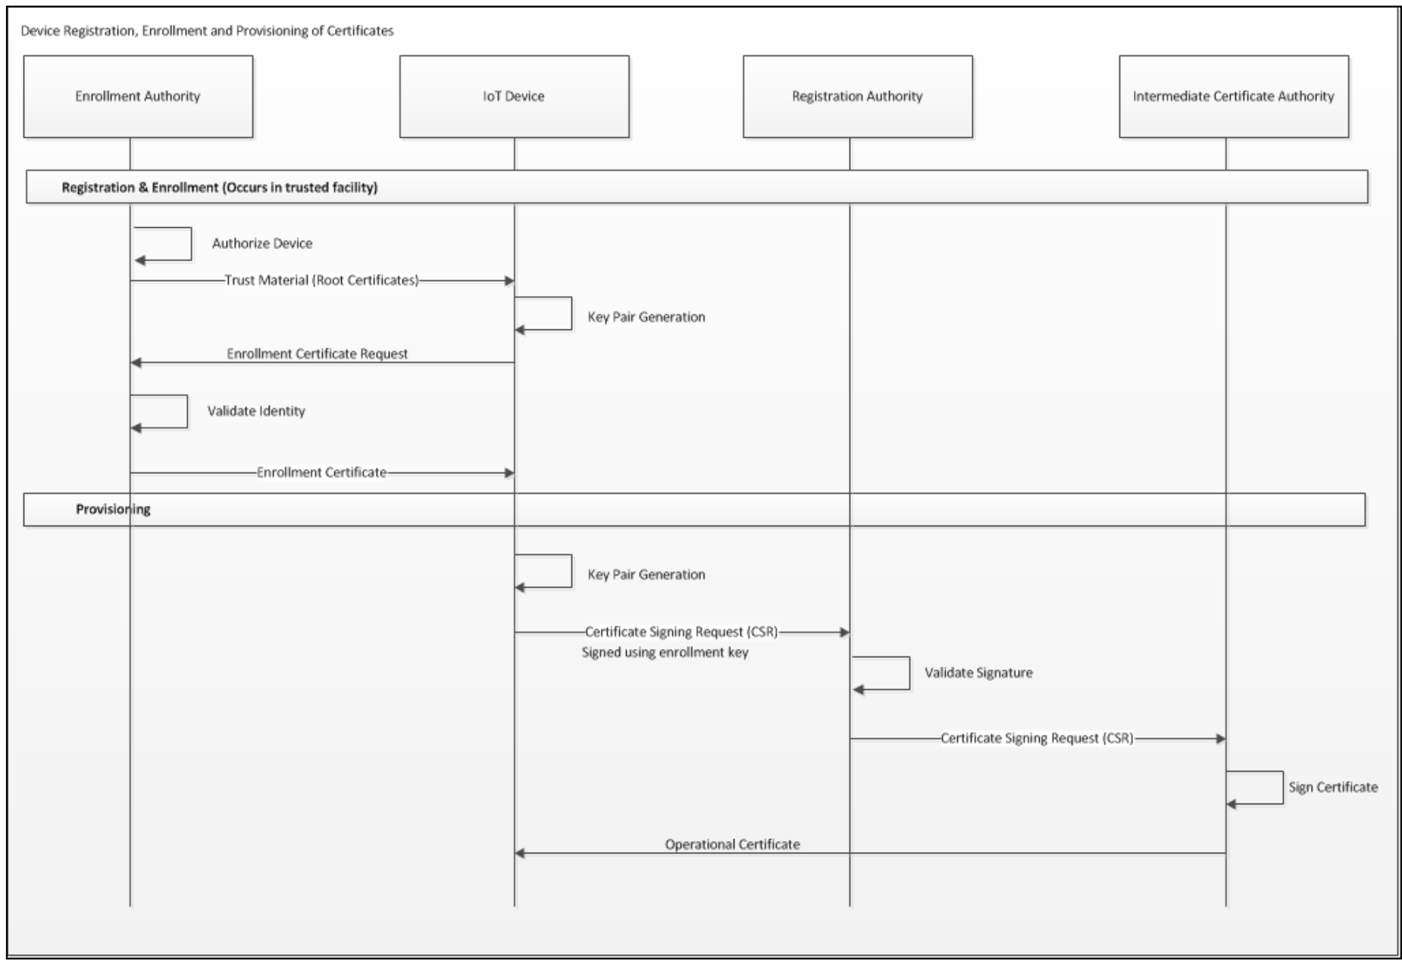
Credential and attribute provisioning

Slide 12
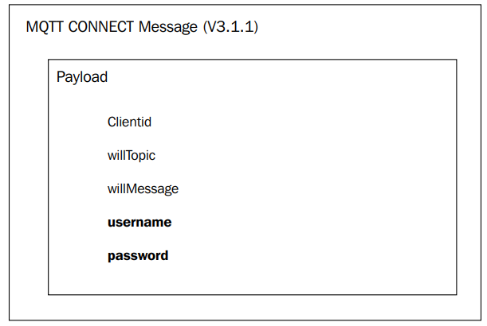
Authentication credentials
Passwords
Some protocols, such as MQTT, only provide the ability to use a username/ password combination for native-protocol authentication purposes. Within MQTT, the CONNECT message includes the fields for passing this information to an MQTT Broker.

Slide 13
Authentication credentials
Symmetric keys
Symmetric key material may also be used to authenticate
Message authentication codes (MACs) are generated using a MAC algorithm (such as HMAC, CMAC, and so on) with a shared key and known data (signed by the key).
On receiving side, an entity can prove the sender possessed the pre-shared key when the its computed MAC is shown to be identical to the received MAC

Slide 14
Authentication credentials
Certificates
Digital certificates, public key-based, are a preferred method for providing authentication functionality in the IoT
X.509
Certificates come with a highly organized hierarchical naming structure that consists of organization, organizational unit(s), and distinguished names (DN) or common names (CN)

Slide 15
Q&A

